Slide 1

Difficulty Scaling of Game AI
Jon Vegard Jansen and Robin Tollisen
Supervisor: Sondre Glimsdal
Notes:
Aak Oop Chi

Slide 2
Agenda
Background
Paper Structure
Dynamic Scripting
Difficulty Scaling
Experiments and Results
Our Advanced Project
Comparison with our Advanced Project
Relevance
Notes:
Chi

Slide 3
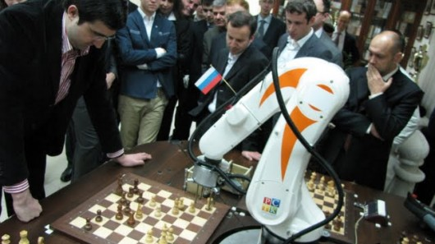
Background
Even games
Difficulty Scaling of Game AI
Earlier work – Dynamic Scripting
Figure 1: http://images.gizmag.com/hero/kramnik-chess-robot.JPG
Notes:
Tor-Erik
Robin has programmed, the rest has written.
Robin secretary.
Worked with Org432 report.

Slide 4
Paper Structure
Abstract
Introduction
Dynamic Scripting
Difficulty Scaling – Three Enhancement Techniques
Experiments
Discussion
Conclusion and Future Work
Notes:
Tor-Erik
Read. Done.
Fill in.

Slide 5
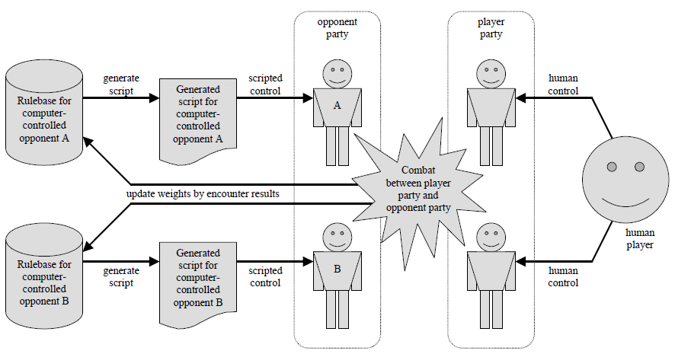
Dynamic Scripting
Figure 2: Dynamic Scripting [1]
Notes:
Chichichi

Slide 6
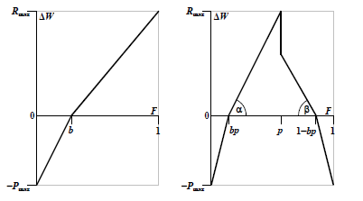
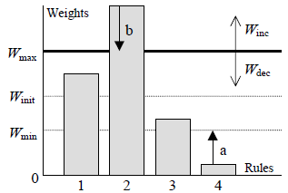
Difficulty Scaling
Difficulty Scaling
Enhancement Techniques
  High-Fitness Penalising
  Weight Clipping
  Top Culling
Figure 3: High-Fitness Penalising [1]
Figure 4: Weight Clipping and Top Culling [1]
Notes:
Chichichi

Slide 7
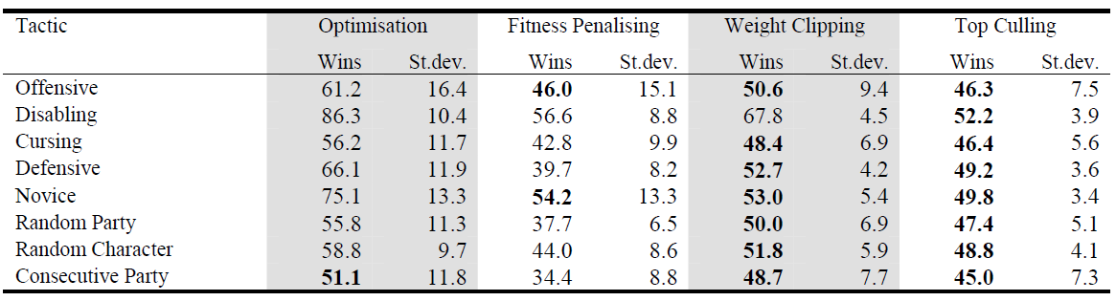
Experiments and Results
Static Scripts vs. Dynamic Scripts
100 tests with 50+100 battles, where a good interval is [45,55]
  Figure 5: Experiments and Results [1]
Notes:
Chichichi

Slide 8
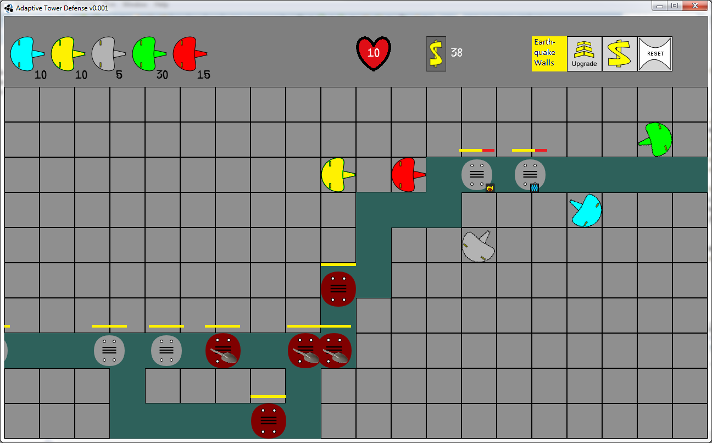
Our Advanced Project
Adaptive Tower Defence Game
  Maximize fun
  Stochastic Hillclimbing Algorithm
  Parameters
Figure 6: Adaptive Tower Defence by Jon Vegard Jansen and Robin Tollisen, UiA Grimstad
Notes:
Chichichi

Slide 9
Comparison with Our Advanced Project
Difficulty only vs. Maximize fun
AI Tactics vs. Parameters
Optimization Penalising vs. Stochastic Hillclimbing Algorithm
Adaptive Game AI vs. Adaptive Game
Notes:
Chichichi

Slide 10
Relevance
Very specialized
Dive deeper into Dynamic Scripting
Notes:
Jon Vegard
[VGW] WOHOO

Slide 11
Questions?

Slide 12
References
[1]: Spronck,P., I. Sprinkhuizen-Kuyper and E. Postma,
Difficulty Scaling of Game AI. GAME-ON 2004: 5th
International Conference on Intelligent Games and
Simulation (eds. El Rhalibi, A., and D. Van Welden), pp. 33-
37. EUROSIS, Belgium, 2004.
Notes:
Jon Vegard
[VGW] WOHOO

